Slide 1
Java Servlets and JSP
Web Server Programming
Lecturer: Shakhnoza Muksimova

Slide 2
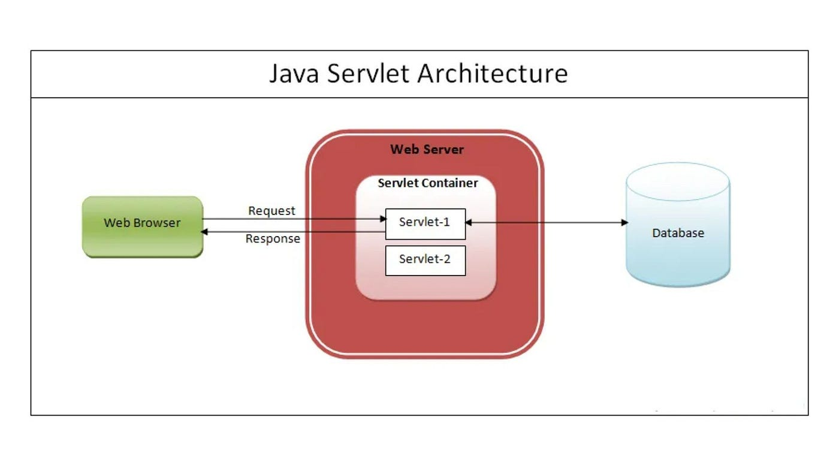
Understanding Servlets
Servlets, at their core, are Java classes that extend the capabilities of servers to enhance the functionality of web applications. They provide a server-side component model that is both platform-independent and scalable. Servlets operate on the server side, responding to client requests and generating dynamic content.

Slide 3
Setting Up Your Servlet Environment
Before delving into Servlet code, it’s essential to set up a development environment. Ensure you have Java Development Kit (JDK) and an integrated development environment (IDE) like Eclipse or IntelliJ IDEA.

Slide 4
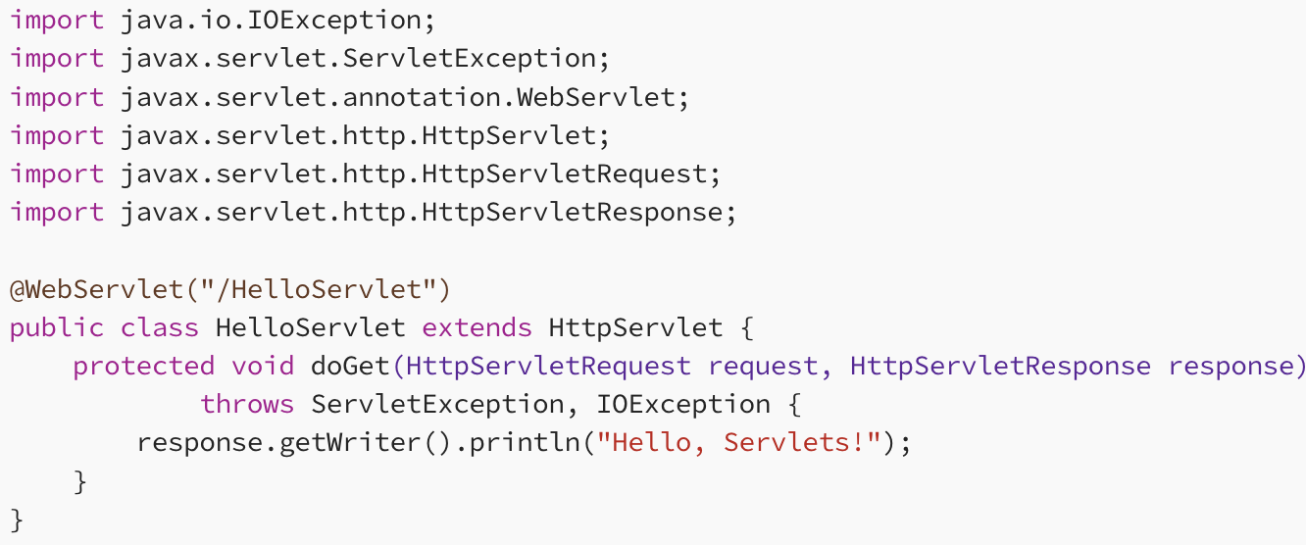
Creating First Servlet
In this example, we create a class HelloServlet that extends HttpServlet. The doGet method handles HTTP GET requests, and it simply writes "Hello, Servlets!" to the response.

Slide 5
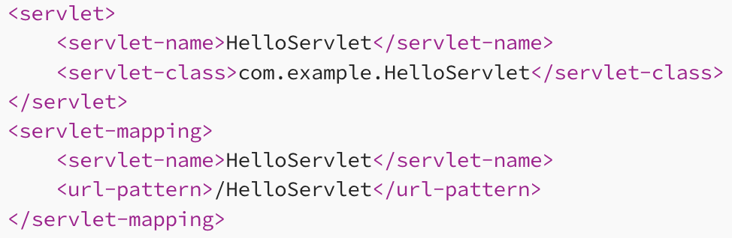
Mapping Servlets in the Deployment Descriptor (web.xml)
For Servlets to be accessible, they need to be mapped in the web.xml deployment descriptor.
This XML configuration informs the servlet container about the servlet’s name, class, and URL pattern.

Slide 6
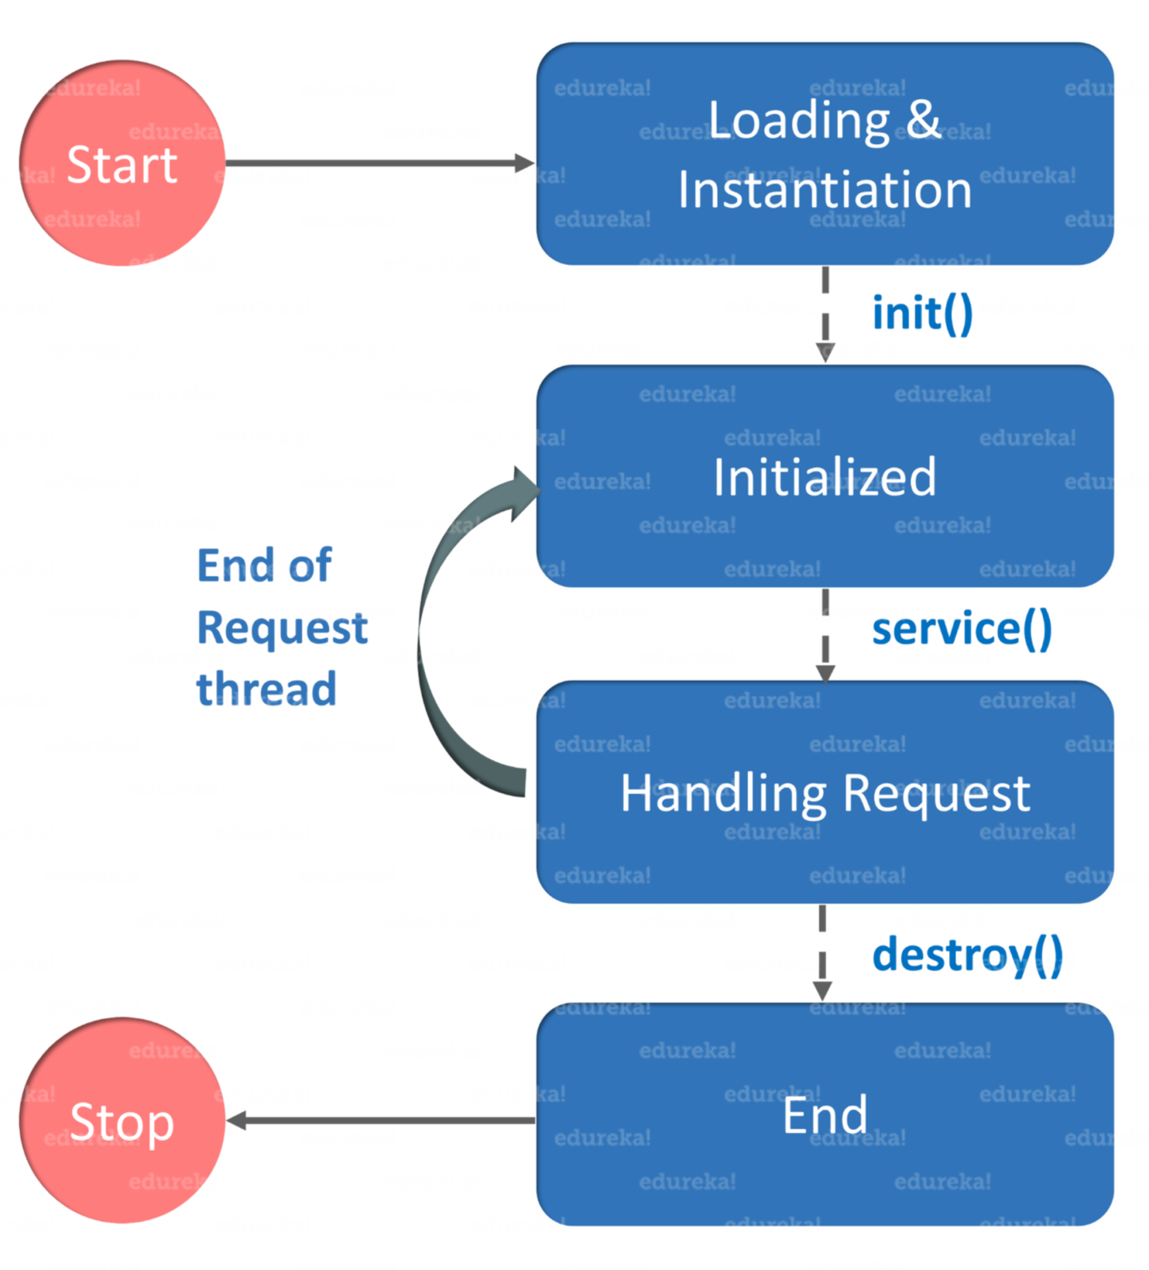
Servlet Life Cycle
The entire life cycle of a servlet is managed by the Servlet container which uses the javax.servlet.Servlet interface to understand the Servlet object and manage it.
Loading a Servlet
When a server starts up, the servlet container deploy and loads all the servlets.
Initializing the Servlet
Next, a servlet is initialized by calling the init() method. Servlet.init() method is called by the Servlet container to notify that this Servlet instance is instantiated successfully and is about to put into service.
Request handling
Then, servlet calls service() method to process a client’s request and is invoked to inform the Servlet about the client requests.
Destroying the servlet
Finally, a servlet is terminated by calling the destroy(). The destroy() method runs only once during the lifetime of a Servlet and signals the end of the Servlet instance.
init() and destroy() methods are called only once. Finally, a servlet is garbage collected by the garbage collector of the JVM. So this concludes the life cycle of a servlet.

Slide 7
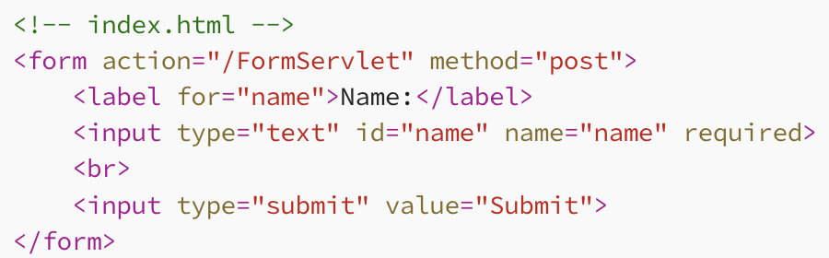
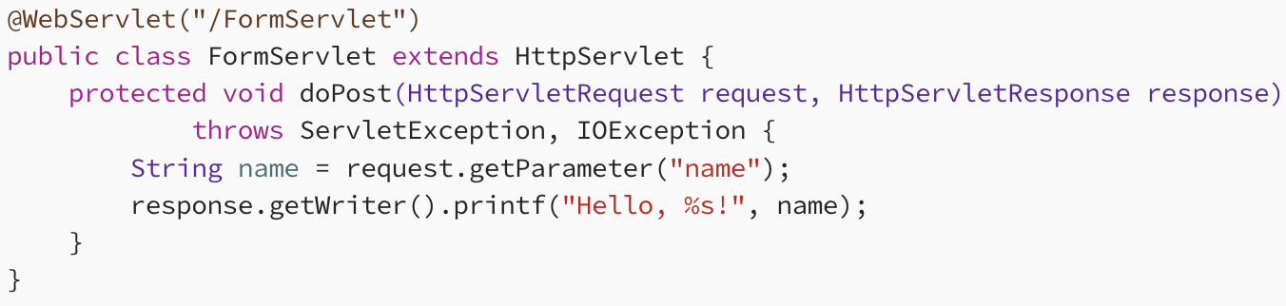
Servlets and Form Handling
Servlets play a pivotal role in processing HTML forms. Let’s create a simple form-handling servlet.

Slide 8
Understanding RESTful API
REST (Representational State Transfer) is an architectural style that uses a stateless, client-server communication model. A RESTful API is an interface that allows systems to communicate over HTTP, following REST principles. Key aspects of RESTful APIs include statelessness, resource-based URLs, and support for standard HTTP methods (GET, POST, PUT, DELETE).

Slide 9
Why Servlets for RESTful APIs?
Servlets, a fundamental part of Java EE (Enterprise Edition), are the perfect building blocks for creating RESTful APIs. They offer the following advantages:
Mature Ecosystem: Servlets have been a part of Java EE for a long time, making them a mature and well-supported technology.
HTTP Handling: Servlets are specifically designed to handle HTTP requests and responses, aligning perfectly with the nature of RESTful communication.
Flexibility: Servlets provide the flexibility to handle various aspects of the API, including request parsing, data processing, and response generation.

Slide 10
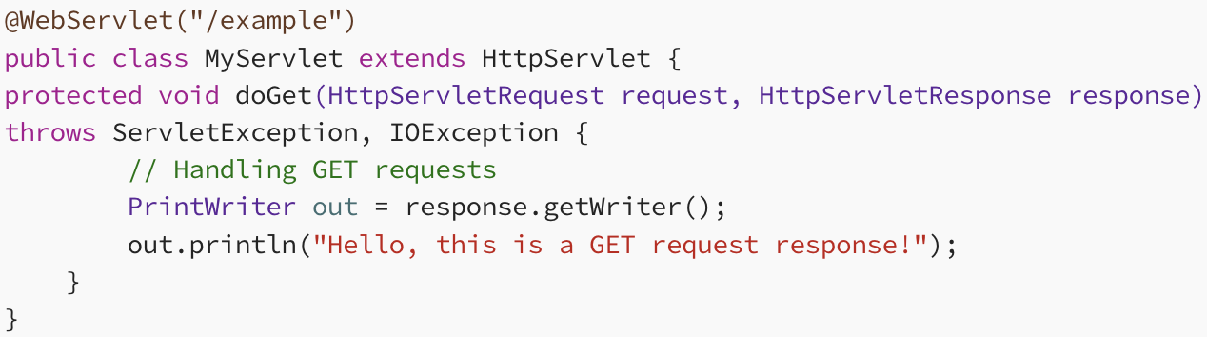
Building a Simple RESTful API with Servlets
Let’s create a basic example of a RESTful API using Servlets. Assume we are building an API for managing a collection of books.
1. doGet Method:
Description: Handles HTTP GET requests.
Use Case: Ideal for retrieving information from the server. Parameters are appended to the URL.

Slide 11
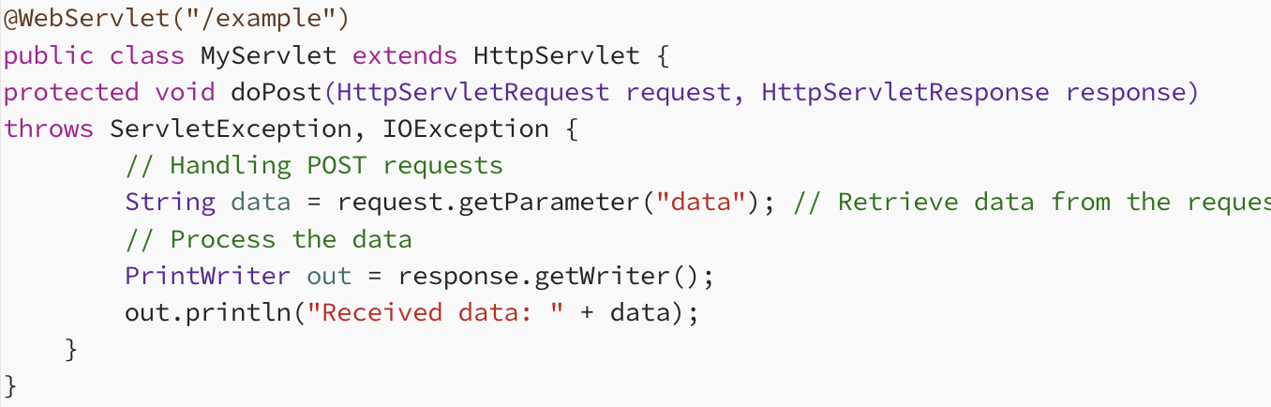
2. doPost Method:
Description: Handles HTTP POST requests.
Use Case: Used for submitting data to be processed to a specified resource. Commonly used for form submissions.

Slide 12
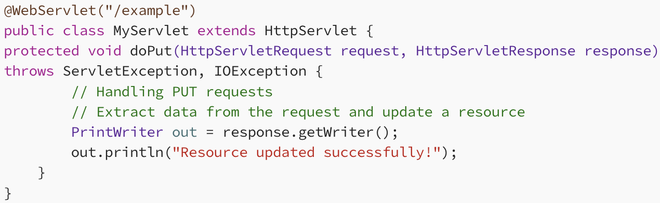
3. doPut Method:
Description: Handles HTTP PUT requests.
Use Case: Typically used for updating a resource on the server. The entire representation of the resource is sent in the request.

Slide 13
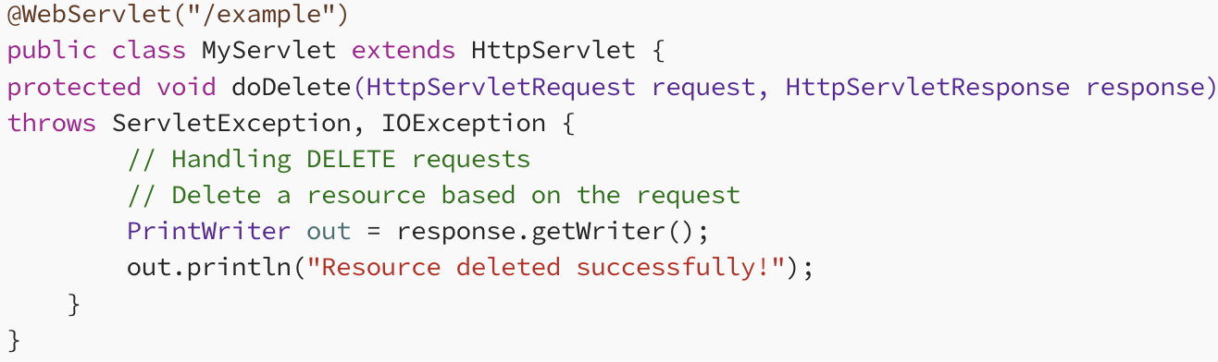
4. doDelete Method:
Description: Handles HTTP DELETE requests.
Use Case: Used to request that a resource be removed. Can delete a specified resource on the server.

Slide 14
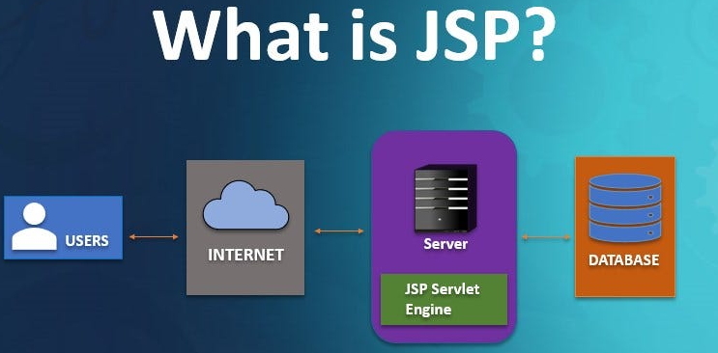
Understanding JavaServer Pages (JSP)
JavaServer Pages, commonly known as JSP, provide a simplified way to create dynamic content for web applications. They are an integral part of the Java EE (Enterprise Edition) technology, enabling developers to embed Java code within HTML pages. JSP pages are ultimately translated into servlets by the web container during runtime.

Slide 15
Setting Up Your JSP Environment
Before diving into JSP development, ensure you have the Java Development Kit (JDK) installed on your system. Additionally, set up a web container like Apache Tomcat to deploy and run your JSP applications.
https://www.geeksforgeeks.org/installation-guide/download-and-install-jdk-on-windows-mac-and-linux/
https://www.geeksforgeeks.org/devops/how-to-start-tomcat-server/

Slide 16
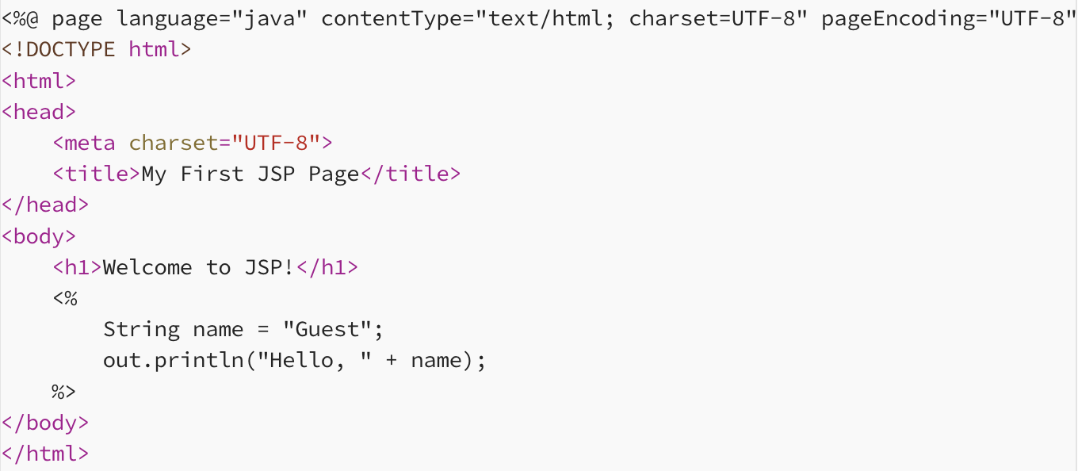
The Anatomy of a JSP Page
A JSP page combines HTML and Java code to create dynamic content. The Java code in JSP is enclosed within <% %> tags.
In this example, we declare the page’s language as Java, set the character encoding, and then use Java code to dynamically generate content within the HTML structure.

Slide 17
JSP Directives: Enhancing Control
JSP directives provide additional information to the container during the translation phase. The <%@ page %> directive, seen in the previous example, is commonly used. Another useful directive is <%@ include %>, which allows including external files in the JSP page.

Slide 18
JSP Actions: Encapsulating Dynamic Behavior
JSP actions are special tags that encapsulate dynamic behavior, enhancing code modularity. For instance, the <jsp:useBean> action simplifies JavaBean integration into JSP pages.
<jsp:useBean id="user" class="com.example.User" scope="session" />
This action creates a session-scoped JavaBean named “user.”

Slide 19
Expression Language (EL): Streamlining Data Access
Expression Language, or EL, simplifies the retrieval of data from Java objects. It provides an elegant way to access object properties without using scriptlets.
<p>Welcome, ${user.name}!</p>
Here, EL fetches the “name” property from the “user” JavaBean.

Slide 20
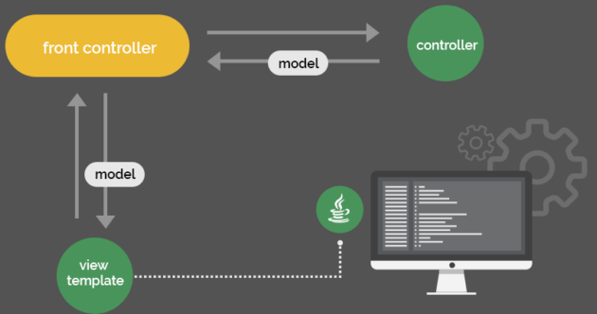
JSP and MVC Architecture
JSP plays a crucial role in the Model-View-Controller (MVC) architecture. It is often employed as the view component, responsible for presenting data to users. Combined with servlets (controller) and JavaBeans (model), JSP facilitates the creation of scalable and maintainable web applications.

Slide 21
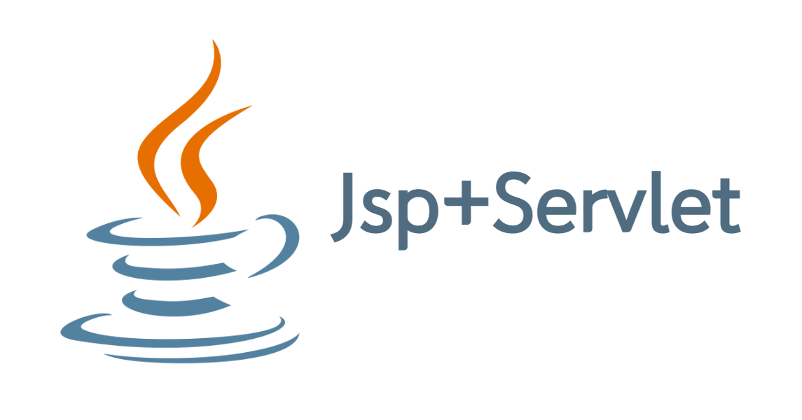
Integrating Servlets and JSP

Slide 22
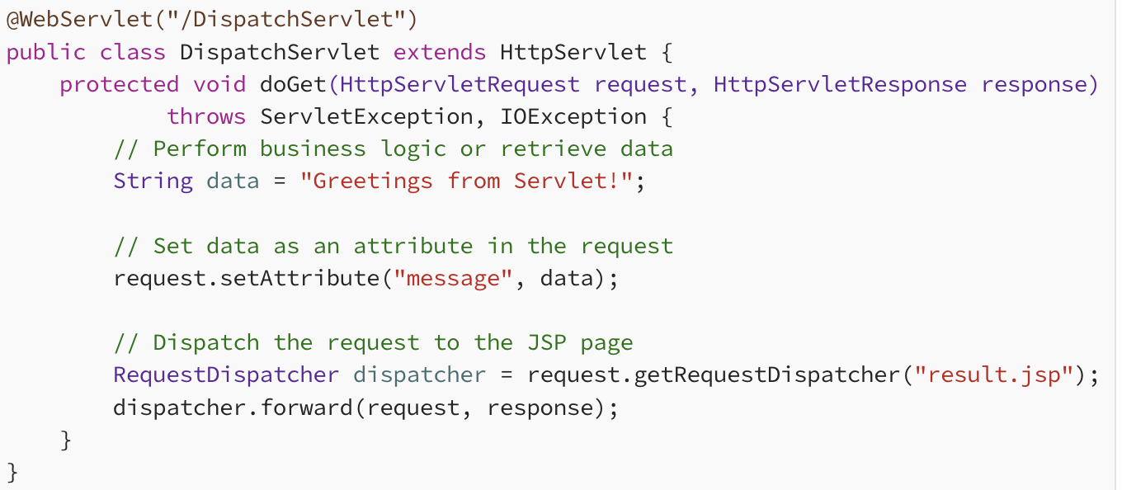
1. Servlet Dispatching to JSP
Servlets can dispatch requests to JSP pages, allowing for the separation of concerns in web application development.

Slide 23
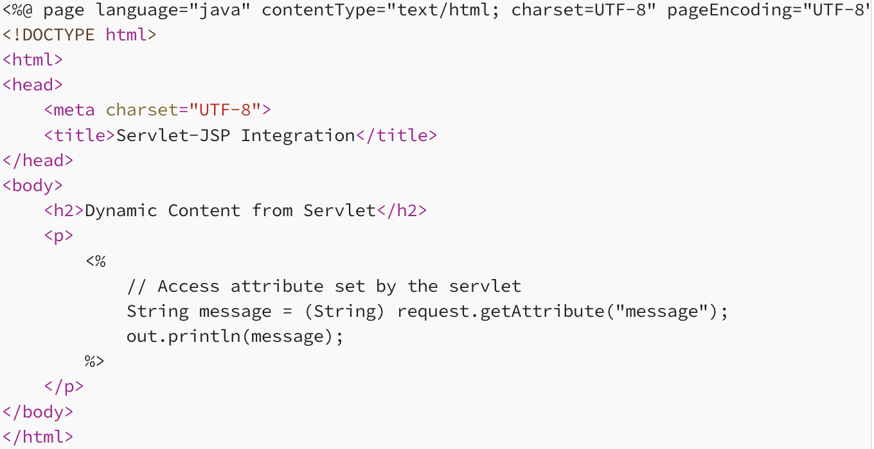
2. JSP Accessing Servlet Attributes
In the JSP page, we can access the attributes set by the servlet and dynamically render content based on the provided data.

Slide 24
Advantages of Using Servlets and JSP Together
Clear Separation of Concerns: Servlets handle business logic and data processing, while JSP focuses on presenting the data to users. This separation enhances maintainability.
Reusability: Servlets can be reused for different views, and JSP pages can be shared among multiple servlets.
Simplified Development: JSP simplifies the integration of Java code with HTML, providing a more natural way to create dynamic content.
Scalability: The MVC architecture facilitated by Servlets and JSP allows for scalable and modular web application development.

Slide 25
Conclusion
The integration of Servlets and JSP brings a powerful combination to web development. Servlets handle the back-end logic and data processing, while JSP pages provide a flexible and dynamic way to present information to users. By mastering the collaboration of these technologies, developers can create web applications that are not only robust and scalable but also maintainable and efficient. Embrace the synergy of Servlets and JSP to unlock the full potential of Java in web development.

